Slide 1

LEVERAGING SOFTMAX AND DEEP NEURAL NETWORKS FOR ENHANCED MOVIE RECOMMENDATIONS
Department of Computer Science and Engineering
Seshadri Rao Gudlavalleru Engineering College, Gudlavalleru
Under the Guidance of
Dr. N. RAJESWARI, M. Tech., Ph.D.
Professor, Department of CSE
By
R. L. PRASOON KUMAR 20481A05K0
Y. RUDRA PRAKASH 20481A05P5
V. DUNESH 20481A05O3
Y. NAGA SANDEESH 20481A05P3

Slide 2
TABLE OF CONTENTS
Leveraging Softmax and Deep Neural Networks For Enhanced Movie Recommendations
Abstract
Objectives
Terminology
Recommendation Systems Overview
Related Work
Methodology
Implementation of the Project
Conclusion

Slide 3
Leveraging Softmax and Deep Neural Networks For Enhanced Movie Recommendations
ABSTRACT
Collaborative filtering research has found success with the learning technique known as Maximum Margin Matrix Factorization (MMMF). In order to simultaneously approximate the observed entries under a partially observed ordinal rating matrix, low-norm latent component matrices U (of users) and V (of items) must be determined. Unobserved entries are measured and predicted by some loss. Since there are 5 levels (1,2,3,4,5) in the rating matrix, rows of V can be thought of as points in k-dimensional space and rows of U as decision hyperplanes. This will employ a neural network architecture to perform the matrix
factorization task and the hinge loss function is specifically extended to accommodate several levels in order to handle rating matrices with multiple discrete values. Along with learning user and item latent vectors, And additionally learn another vector θ, unique for each user, that separates the user-item interaction hyperplanes. We employ only item embeddings depending on number of possible ratings.

Slide 4
Leveraging Softmax and Deep Neural Networks For Enhanced Movie Recommendations
OBJECTIVES
1. Enhanced Efficiency
2. Streamlined Model Architecture
3. Handling Multiple Discrete Values
4. Comparative Evaluation
5. Robustness to Sparse Data
6. Scalability and Generalization

Slide 5
TERMINOLOGY
Leveraging Softmax and Deep Neural Networks For Enhanced Movie Recommendations
Items (also known as documents)
The entities a system recommends. For the Google Play store, the items are apps to install. For YouTube, the items are videos.
Query (also known as context)
The information a system uses to make recommendations. Queries can be a combination of the following:
user information
the id of the user
items that users previously interacted with
additional context
time of day
the user's device
Embedding
A mapping from a discrete set (in this case, the set of queries, or the set of items to recommend) to a vector space called the embedding space. Many recommendation systems rely on learning an appropriate embedding representation of the queries and items.

Slide 6
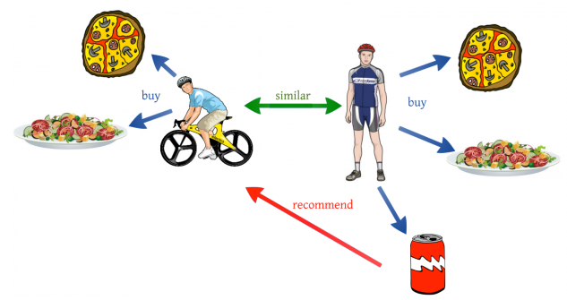
Recommender Systems
Leveraging Softmax and Deep Neural Networks For Enhanced Movie Recommendations
Data here, data there, data everywhere.
There is a need to derive meaningful insights that can help
organizations for better functioning,
assist user in his/her decision making process.
The amount of data is enormous and therefore requires a large amount of time to explore all of them.
To avoid the information overload, we need some assistance in the form of recommendation in our day to day life.

Slide 7



Recommender Systems
Leveraging Softmax and Deep Neural Networks For Enhanced Movie Recommendations
Recommendation systems (RS) help to match users with items
Ease information overload
Sales assistance (guidance, advisory, persuasion,…)
RS seen as a function
Given:
User model (e.g. ratings, preferences, demographics, situational context)
Items (with or without description of item characteristics)
Find:
Relevance score. Used for ranking.

Slide 8
ARCHITECTURE
Leveraging Softmax and Deep Neural Networks For Enhanced Movie Recommendations
One common architecture for recommendation systems consists of the following components:
candidate generation
scoring
re-ranking
Candidate Generation
In this first stage, the system starts from a potentially huge corpus and generates a much smaller subset of candidates.
Scoring
Next, another model scores and ranks the candidates in order to select the set of items (on the order of 10) to display to the user.
Re-ranking
Finally, the system must take into account additional constraints for the final ranking. For example, the system removes items that the user explicitly disliked or boosts the score of fresher content

Slide 9
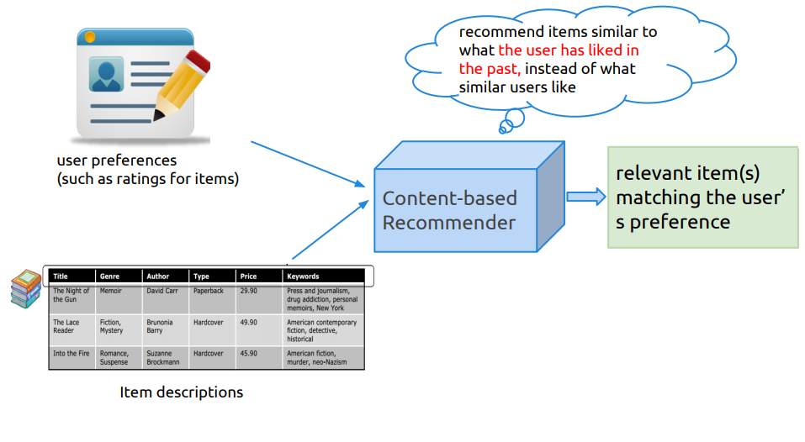
Content-based Recommendation
Leveraging Softmax and Deep Neural Networks For Enhanced Movie Recommendations

Slide 10
Content-based Recommendation
Leveraging Softmax and Deep Neural Networks For Enhanced Movie Recommendations
PROS
The model doesn't need any data about other users, since the recommendations are specific to this user. This makes it easier to scale to a large number of users.
The model can capture the specific interests of a user, and can recommend niche items that very few other users are interested in.
CONS
Since the feature representation of the items are hand-engineered to some extent, this technique requires a lot of domain knowledge. Therefore, the model can only be as good as the hand-engineered features.
The model can only make recommendations based on existing interests of the user. In other words, the model has limited ability to expand on the users' existing interests.

Slide 11
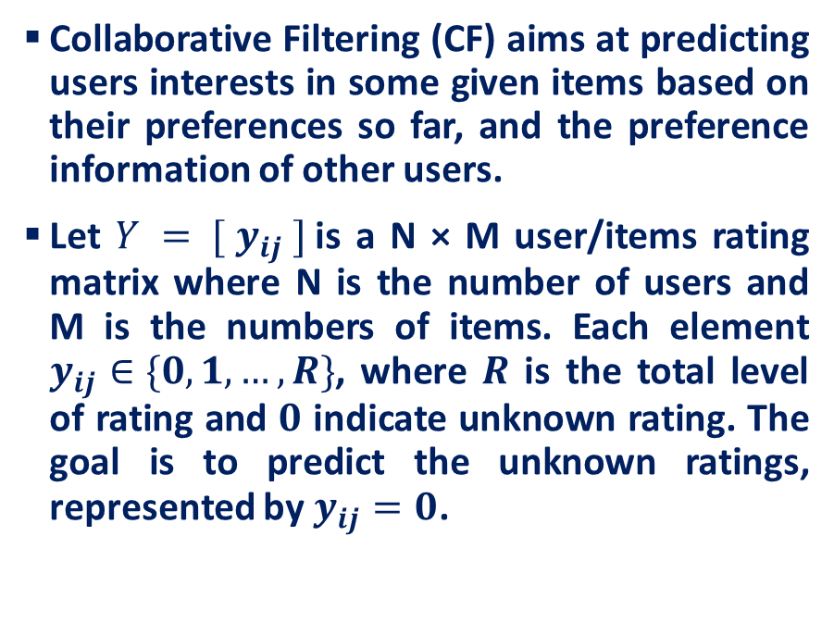
Collaborative Filtering
Leveraging Softmax and Deep Neural Networks For Enhanced Movie Recommendations
Movies
0 | 4 | 0 | 0 | 1 | 0 | 0
0 | 0 | 0 | 4 | 0 | 0 | 3
2 | 0 | 0 | 0 | 3 | 0 | 5
0 | 5 | 0 | 0 | 1 | 3 | 0
3 | 0 | 1 | 0 | 5 | 0 | 0
0 | 2 | 0 | 4 | 0 | 0 | 1
0 | 0 | 5 | 0 | 0 | 2 | 0
1 | 0 | 0 | 3 | 0 | 0 | 4
Users
Will user I like movie J ?

Slide 12
Collaborative Filtering
Leveraging Softmax and Deep Neural Networks For Enhanced Movie Recommendations
PROS
No domain knowledge necessary
We don't need domain knowledge because the embeddings are automatically learned.
Great starting point
To some extent, the system needs only the feedback matrix to train a matrix factorization model. In particular, the system doesn't need contextual features. In practice, this can be used as one of multiple candidate generators.
CONS
Cannot handle fresh items (Cold Start Problem)

Slide 13
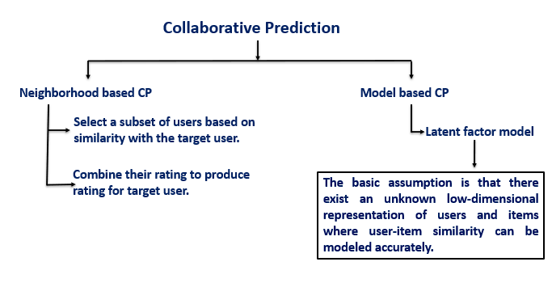
Leveraging Softmax and Deep Neural Networks For Enhanced Movie Recommendations
RELATED WORK

Slide 14
Leveraging Softmax and Deep Neural Networks For Enhanced Movie Recommendations
RELATED WORK
In the context of recommender systems, embeddings are used to represent users and items in a lower-dimensional space, capturing the latent factors that describe user preferences and item characteristics.
In Maximum Margin Matrix Factorization (MMMF), three types of embeddings are often used: user embeddings, item embeddings, and theta embeddings.
User embeddings represent the latent factors of the users.
Item embeddings represent the latent factors of the items.
Theta embeddings are used to capture the interaction between users and items.
As for updating the embeddings, yes, it is common practice in deep learning-based methods to update the embeddings after each iteration.

Slide 15
Leveraging Softmax and Deep Neural Networks For Enhanced Movie Recommendations
METHODOLOGY
Initialization: The values in the two smaller matrices (U and V) are usually initialized randomly. These matrices represent the latent (hidden) features of the users and items. For example, in a movie recommendation system, the latent features could be genres like action, comedy, drama, etc.
2. Multiplication: The dot product of the two matrices U and V approximates the original matrix A.
3. Optimization: The goal is to adjust the values in matrices U and V such that the difference (error) between the original matrix (A) and the product of U and V is minimized.
4. Prediction: Once the matrices U and V have been learned, you can predict the rating of a movie by a user by taking the dot product of the user’s row in U with the movie’s column in V.

Slide 16
Leveraging Softmax and Deep Neural Networks For Enhanced Movie Recommendations
Geometrical Interpretation of Matrix Factorization
When V is fixed, and only the matrix U needs to be learned, then fitting each row of the target matrix Y is a separate linear prediction problem.
Rows of U (Users)
Columns of V^{T} (Movies)

Slide 17
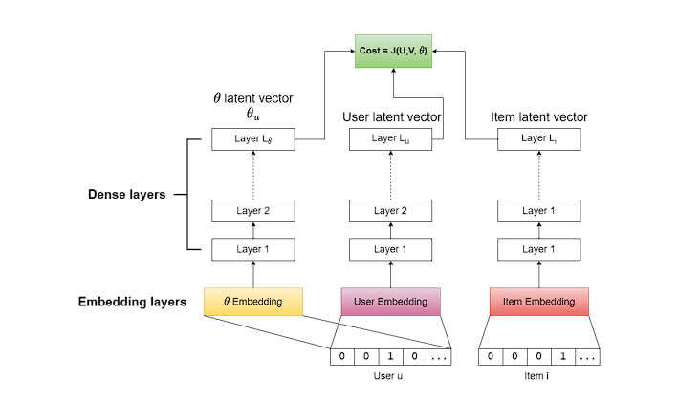
EXISTING NEURAL NETWORK ARCHITECTURE
Leveraging Softmax and Deep Neural Networks For Enhanced Movie Recommendations

Slide 18
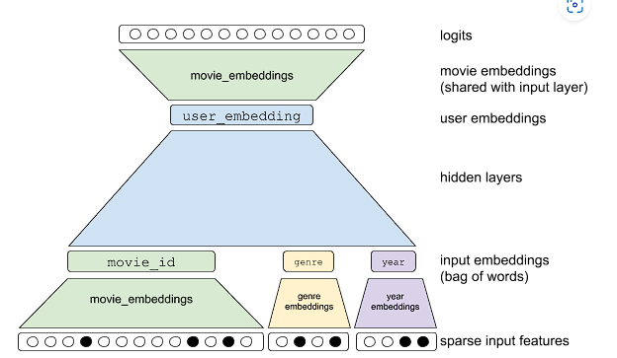
PROPOSED NEURAL NETWORK ARCHITECTURE
Leveraging Softmax and Deep Neural Networks For Enhanced Movie Recommendations

Slide 19
IMPLEMENTATION
Leveraging Softmax and Deep Neural Networks For Enhanced Movie Recommendations
RATINGS FILE==========================================
All ratings are contained in the file "ratings.dat" and are in the following format
UserID::MovieID::Rating::Timestamp
UserIDs range between 1 and 6040 - MovieIDs range between 1 and 3952- Ratings are made on a 5-star scale (whole-star ratings only)- Timestamp is represented in seconds since the epoch as returned by time(2)- Each user has at least 20 ratings
USERS FILE ===========================================================User information is in the file "users.dat" and is in the followingformat:
UserID::Gender::Age::Occupation::Zip-code
Gender is denoted by a "M" for male and "F" for female- Age is chosen from the following ranges:

Slide 20
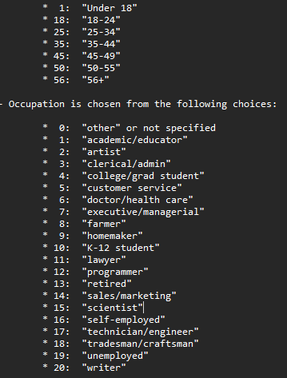
IMPLEMENTATION
Leveraging Softmax and Deep Neural Networks For Enhanced Movie Recommendations
MOVIES FILE DESCRIPTION=======================Movie information is in the file "movies.dat" and is in the following format:
MovieID::Title::Genres
Titles are identical to titles provided by the IMDB (including year of release)
Movie genres include
*Action * Adventure *Animation * Children's *Comedy * Crime *Documentary * Drama * Fantasy *Film-Noir * Horror * Musical *Mystery * Romance *Sci-Fi * Thriller
* War *Western

Slide 21
Leveraging Softmax and Deep Neural Networks For Enhanced Movie Recommendations
Total there are 3952 movies are rated by 6040 users stored in “DAT” format
DATASET SAMPLE
1::Toy Story (1995)::Animation|Children's|Comedy
2::Jumanji (1995)::Adventure|Children's|Fantasy
3::Grumpier Old Men (1995)::Comedy|Romance
4::Waiting to Exhale (1995)::Comedy|Drama
5::Father of the Bride Part II (1995)::Comedy
6::Heat (1995)::Action|Crime|Thriller
7::Sabrina (1995)::Comedy|Romance
8::Tom and Huck (1995)::Adventure|Children’s
9::Sudden Death (1995)::Action
10::GoldenEye (1995)::Action|Adventure|Thriller
11::American President, The (1995)::Comedy|Drama|Romance
12::Dracula: Dead and Loving It (1995)::Comedy|Horror
13::Balto (1995)::Animation|Children’s
14::Nixon (1995)::Drama
15::Cutthroat Island (1995)::Action|Adventure|Romance

Slide 22
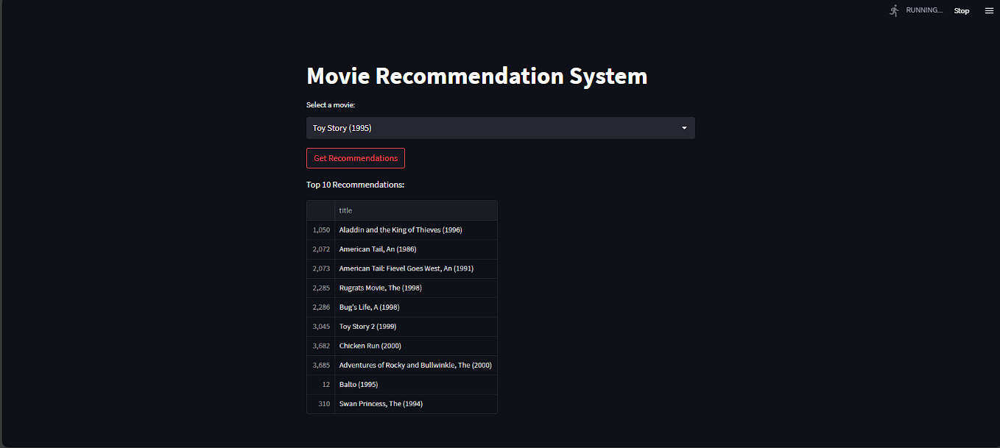
OUTPUT
Leveraging Softmax and Deep Neural Networks For Enhanced Movie Recommendations
Content based recommendation system

Slide 23
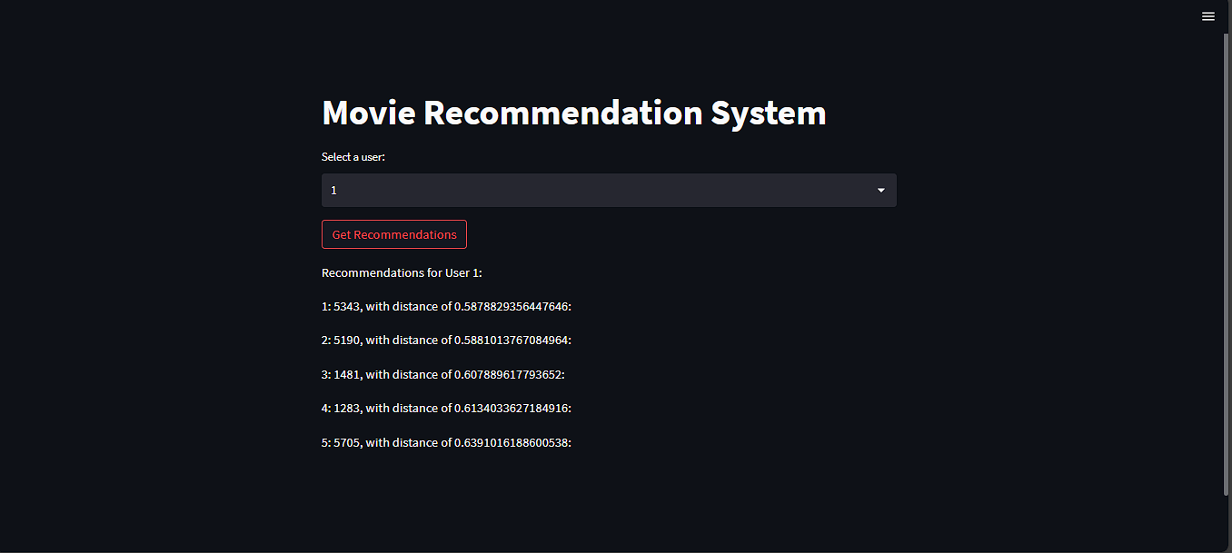
OUTPUT
Leveraging Softmax and Deep Neural Networks For Enhanced Movie Recommendations
Collaborative Filtering based recommender system

Slide 24
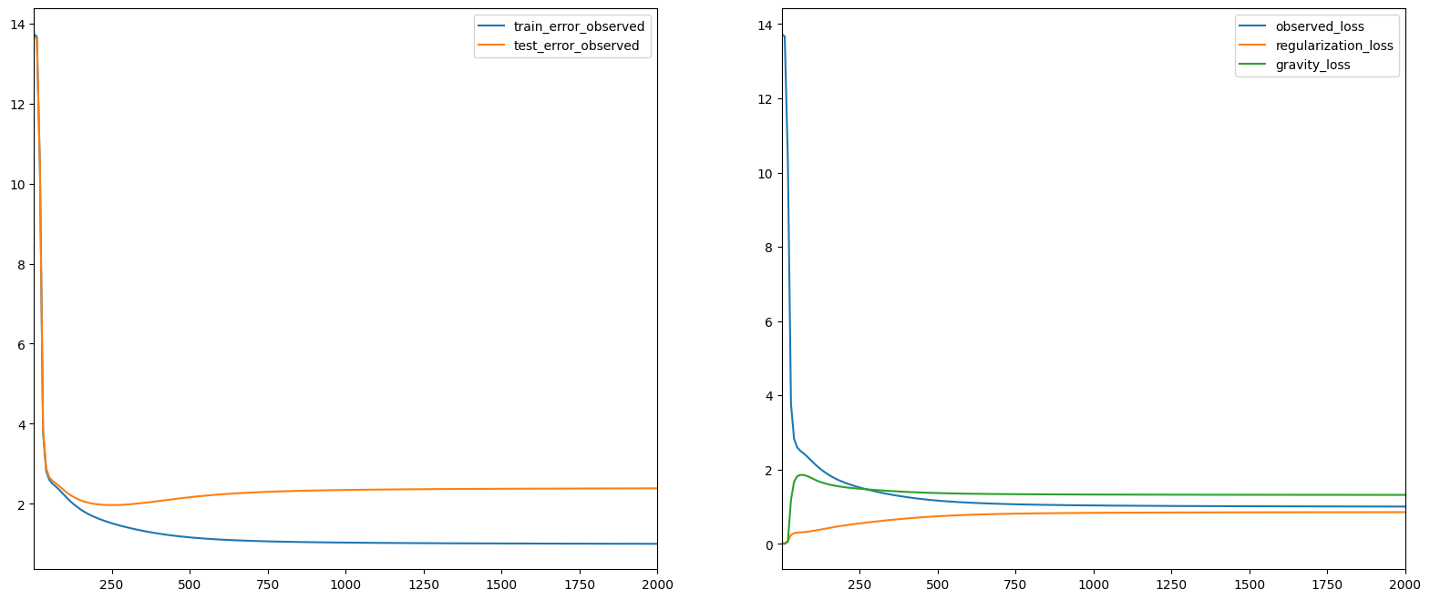
OUTPUT
Leveraging Softmax and Deep Neural Networks For Enhanced Movie Recommendations
Train and Test Error in Deep Neural Network based recommender system

Slide 25
REFERENCES
Leveraging Softmax and Deep Neural Networks For Enhanced Movie Recommendations
Bi, X., Qu, A., Wang, J., & Shen, X. (2017). A group-specific recommender system. Journal of the American Statistical Association, 112(520), 1344–1353.
Fu, M., Qu, H., Yi, Z., Lu, L., & Liu, Y. (2018). A novel deep learning-based collaborative filtering model for recommendation system. IEEE Transactions on Cybernetics, 49(3), 1084–1096.
He, X., Liao, L., Zhang, H., Nie, L., Hu, X., & Chua, T.-S. (2017). Neural collaborative filtering. In Proceedings of the 26th international conference on World Wide Web (pp. 173–182).
Liu, H., Zheng, C., Li, D., Shen, X., Lin, K., Wang, J., Zhang, Z., Zhang, Z., & Xiong, N. N. (2022). Edmf: Efficient deep matrix factorization with review feature learning for industrial recommender system. IEEE Transactions on Industrial Informatics, 18(6), 4361–4371

Slide 26

Leveraging Softmax and Deep Neural Networks For Enhanced Movie Recommendations
CONCLUSION
We have identified different scenarios where our solution will sustain to predict the accurate recommendations of movies given by not only implicit rating but also explicit information including demographics, age, ethnicity etc.,

